Slide 1
Our Quest to Change The World
FIRST Team 195
The Cyber Knights
Southington CT

Slide 2
Introduction
Tyler Brinton- Chairman’s Lead
Gwen Gorman & Bailey Kahl- Chairman’s presenters
Notes:
Hi, My name is Tyler Brinton, I am the Lead of the Chairman’s committee. This is our first season presenting for Chairman’s. Public speaking - not my gift. I am a writer. The words I had to say, are reflected in the essay. I’d like to introduce you to Bailey Kahl and Gwen Gorman. They will be presenting to you the Cyber Knights quest to change the world. 19.5s

Slide 3
Initiatives to Change the World
Veterans Outreach
Inspiring The Youth of Today for a Better Tomorrow
Making FIRST a Household Name in our Community
Making other FIRST Teams Stronger
Notes:
As Tyler said, I’m Gwen Gorman. Many of the initiatives we have implemented are written in the essay, and rather than restating the same information, we would like to talk to you today about the significant positive impact these initiatives have had on our community. and I want to review with you today the significant positive impact that the Cyber Knights have had on our community our efforts to change the world The four key areas we will focus on are: ( read from slide the four items and point to them) 30s

Slide 4
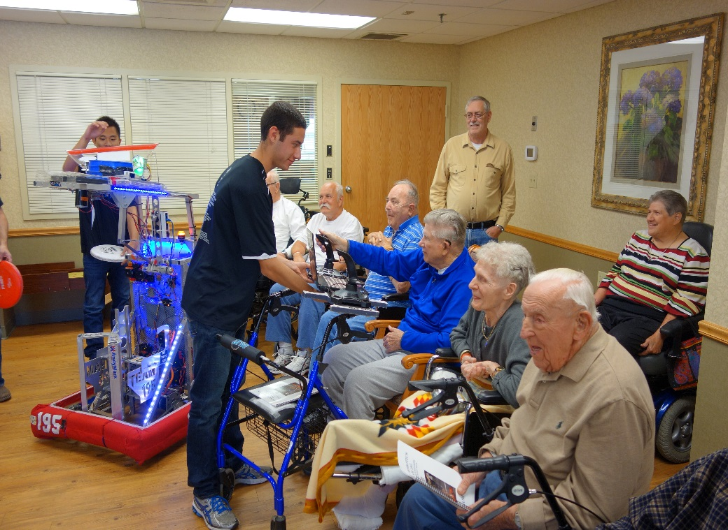
How Have We Encouraged and Supported our Veterans?
The Southington Care Center has a veterans group made of veteran residence.
We Listened to them
We Cared
We Inspired
We Gave Hope
They gave us Inspiration
Notes:
Hi My name is Bailey and I want to talk to you about a group of the community especially important to me- Veterans.
The residence at the Southington care center talked about our visit for weeks. We went to inspire them but instead, they inspired us.
We LISTENED to their stories of service and sacrifice. This meant the world to them.
After hearing of their experiences, we were left with a greater appreciation for their service.
We inspired them and helped them see that the future leaders of tomorrow aren’t very different than they were at our age. We told them about FIRST and it’s purpose to inspire technology leaders who are very much like they were when they were using the cutting edge of technology while they served so many years ago.
We gave Hope and joy. They talked about our visit for weeks to their families and workers. We cannot wait to go back and promised to do so with our new robot
They Inspired us and taught us that EVERY life matters, EVERYONE contributes to the world and just as they helped shape our current history, that we too will change our world/

Slide 5
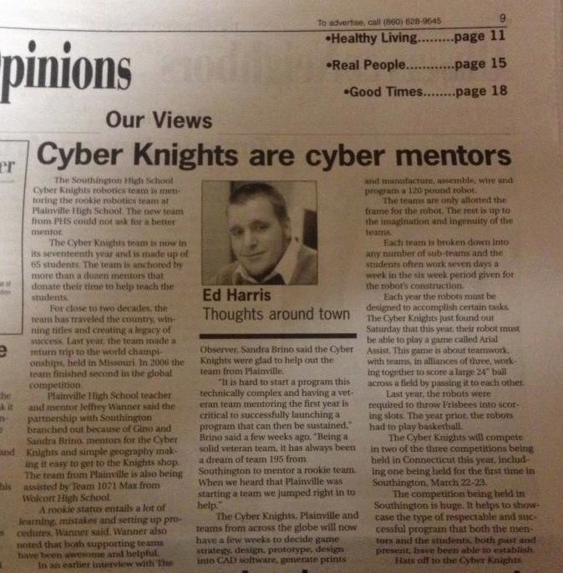
Making FIRST a Household Name In Our Community
3 Years Ago In Southington
“What’s a robotics team? We have one of those?”
Today In Southington
“Hey Honey, the Cyber Knights are on the front page again! I can’t wait to see this year’s robot!”
Notes:
GWEN:
There was a time in our history, just 3 years ago when this is what every Southington resident would say. Very few knew about FIRST or even that their town had a robotics team
Now, with all our outreach to the community, with multiple presentations, parades and news articles we have changed the thought patterns of Southington to raise the importance of this Science and Technology program to the same level as football and Baseball.
We don’t call the newspapers anymore- they call us!
And we will tell you having produced several Pro-Baseball players that’s really saying something about our sports-minded town!
When The town council announced and recognized our football team for winning the LL State Championship just last month, one of the Town Council members spoke up and said. “Let’s not forget the football team are not the only champions in our town. The Robotics Team are our Champions too”.
At the same time, they recognized our team for our successes both on and off the field and gave special mention of our veteran outreach and the impact it has had on our community.

Slide 6
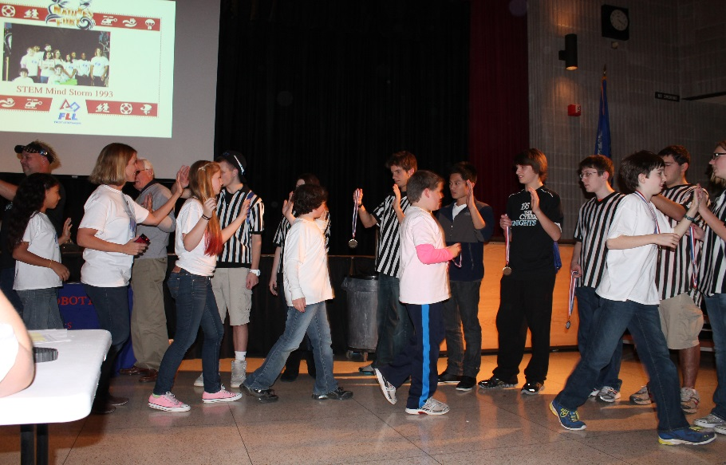
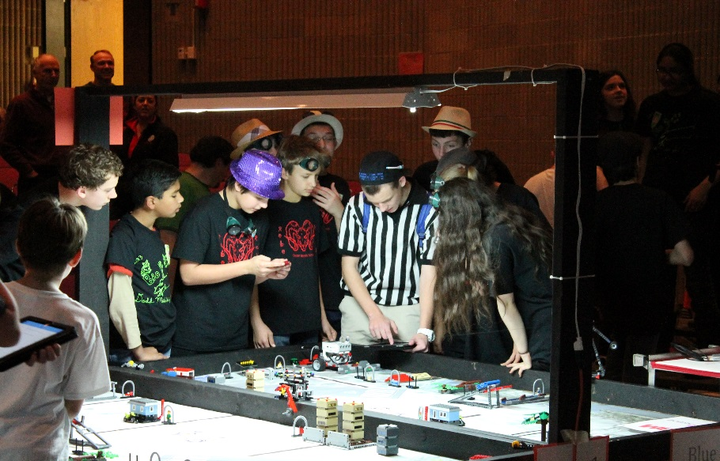
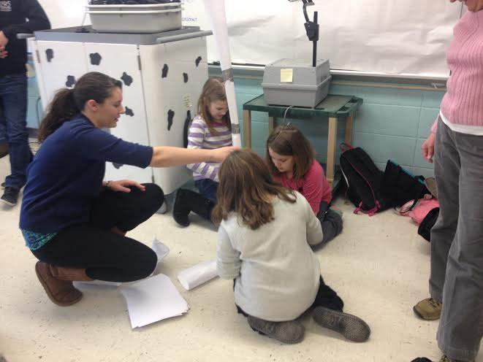
Inspiring The Youth of Today for a Better Tomorrow
Notes:
Bailey:
As you know, we support FLL by volunteering for FLL competitions as well as mentoring a new VEX IQ program in one of our local elementary schools
The look on the students faces is priceless, It is this activity that means the most because we know that at some point in our lives someone turned us on to Science and technology and now we must pay that forward and inspire these young ones to also get excited about it.

Slide 7
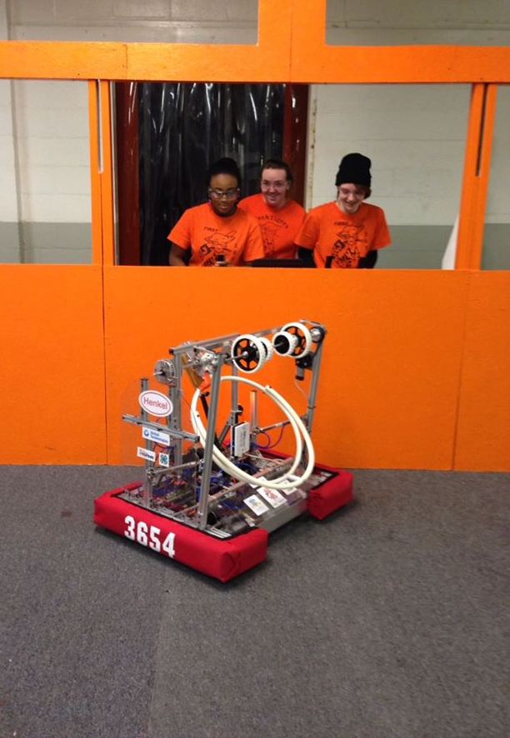
Making Other FIRST Teams Stronger
Kick-starting Team 5129 -a new rookie team
Special importance placed on helping to sustain EXISTING FIRST teams
Fund and build a practice field for all CT Teams to use
Implemented the Connecticut Coalition Online Forum where CT mentors can share information and help each other
Provide programming help to other teams
Attend other teams’ fundraisers
Through these efforts,
we have seen other CT Teams grow
so that together we can all be
“Connecticut Strong”
Notes:
Gwen: As you can read in our essay we are helping to start up team 5129 from Plainville and really enjoy building them up to a sustainable program. But we also consider equally important the need to help EXISTING FIRST teams sustain themselves. We put or outreach to existing teams, some of whom really struggle each season, as a priority just as much as if we were starting a new team.
Team 999

Slide 8
Reflections
We Will Change the World
Notes:
B: My name is Bailey.
G: My name is Gwen. T: And my name is Tyler.
B: We are all unique individuals.
G: I’m an actress. T: I’m a writer.
B: And I’m an athlete.
G: Yet we are a family. T: We compete together.
B: We volunteer together.
G: And we learn to love each other. T: ­­­To us, FRC is much more than just a robotics competition.
B: Through it, we have learned the meaning of dedication.
G: The significance of teamwork.
T: And the importance of compassion.
B: We have learned to appreciate our veterans.
G: To reach out to our community.
T: And to prepare the youth for the future.
B: And together,
G: This family
T: of unique individuals
All: will change the world.

Slide 9

Design Priorities
Fast and maneuverable drive train
Fast and reliable intake
Accurate and consistent shooter
2014 FRC Game, 2014, Retrieved from http://www.usfirst.org/roboticsprograms/frc/2014-game

Slide 10
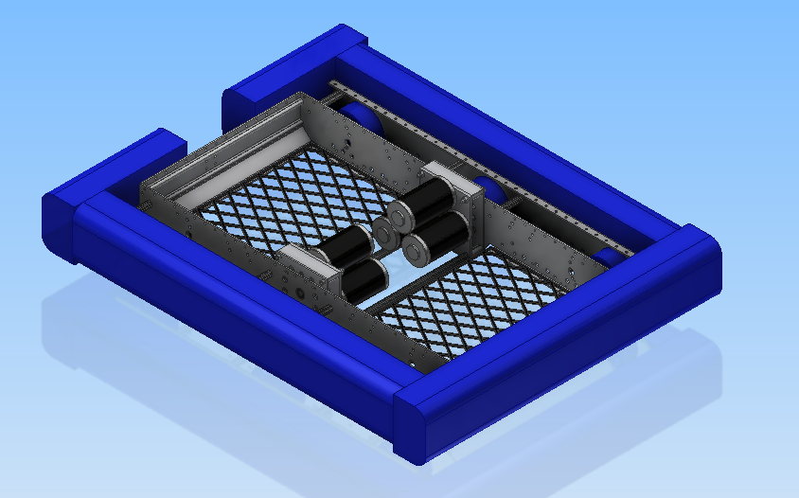
Week 1:Drive Base in CAD
6WD KOP long configuration
2 3-CIM transmissions

Slide 11
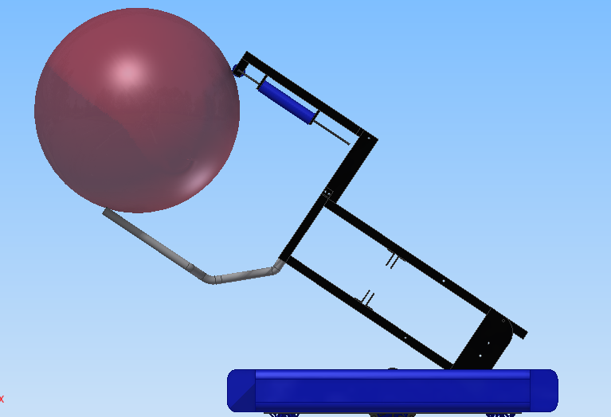
Week 2:Preliminary Arm Design
The Design Team began to make basic parts to visualize how the robot would move, and how the ball would be gathered

Slide 12
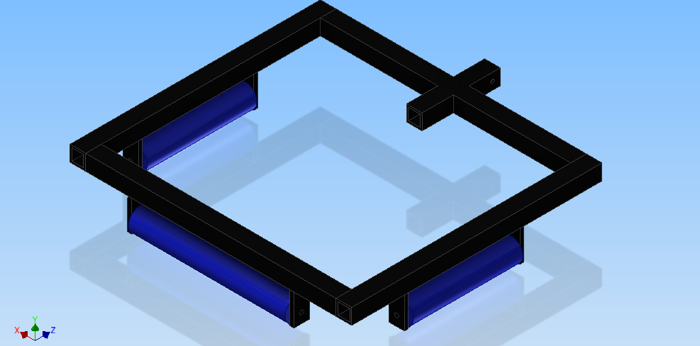
Week 2-3:Prelimianry Intake Design
After deciding on a multi sided intake, the Design Team made an assembly to visualize how the intake would work

Slide 13
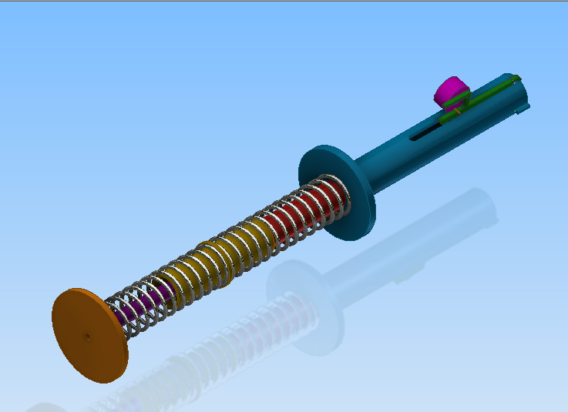
Week 3:Preliminary Shooter Design
The Design Team made a general assembly of a shooter idea to visualize how it would work

Slide 14
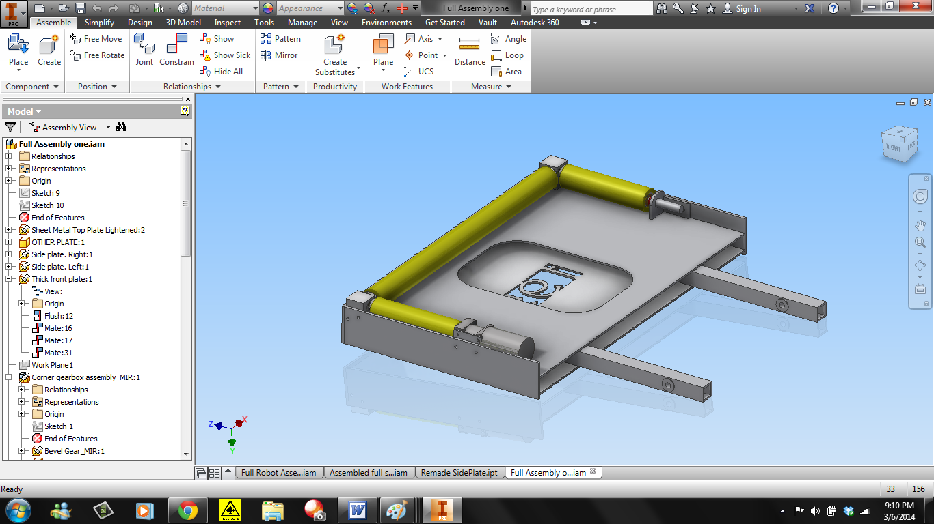
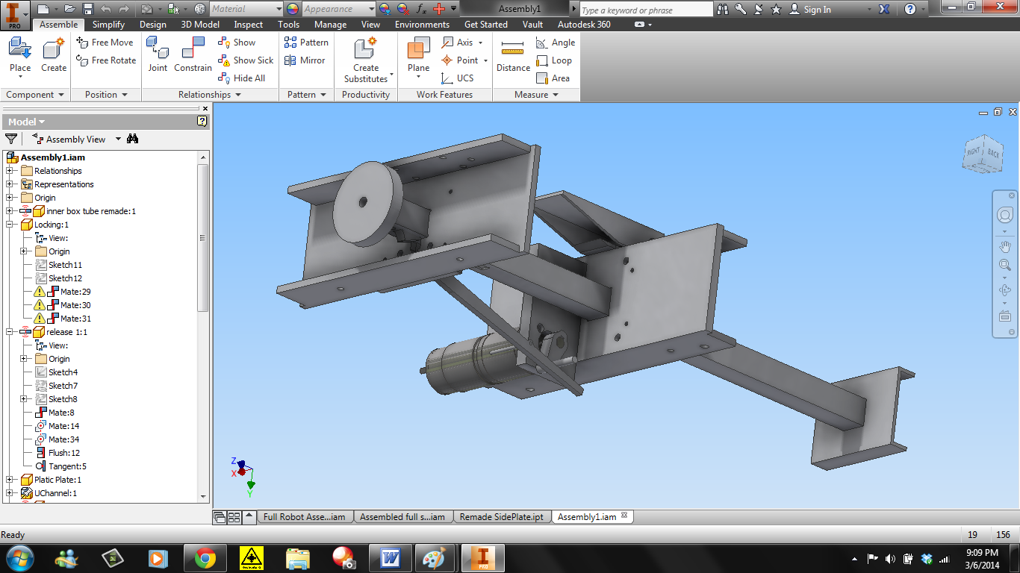
Beginning of Week 4:Final Intake and Shooter
The Design Team completed the shooter and intake in CAD at the beginning of week 4

Slide 15
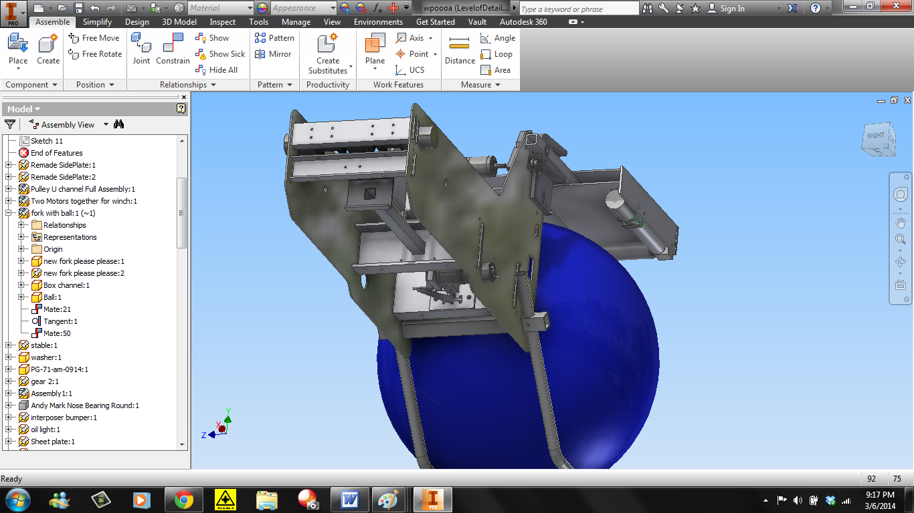
End of Week 4:Arm is Designed
The superstructure that holds the intake and shooter was designed entering week 4

Slide 16
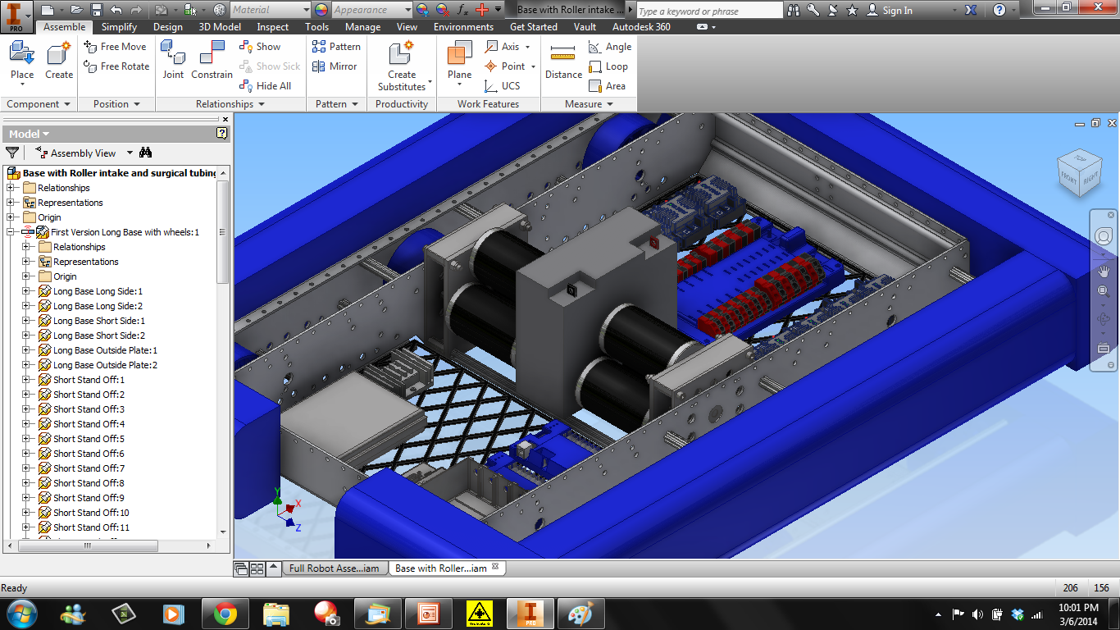
Beginning of Week 5:Electrical Components
The Design Team began to add all electrical components onto the base

Slide 17
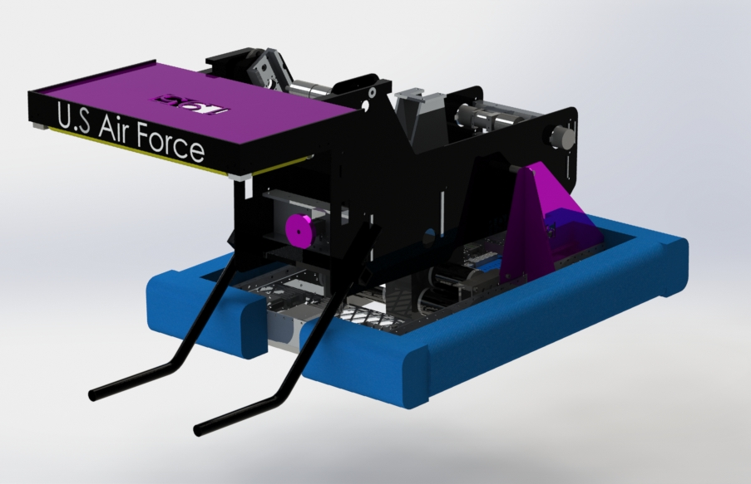
End of Week 5:Final Robot Assembly
Although parts were being made since week 4, the final robot design was finished at the end of week 5

Slide 18

Conclusion: Meeting All Priorities
Fast and reliable intake✓
Fast and maneuverable drive train✓
Accurate and consistent shooter✓
2014 FRC Game, 2014, Retrieved from http://www.usfirst.org/roboticsprograms/frc/2014-game

